Slide 1

Analysis of Adverse Drug Effects Using Big Data and Cloud Computing
Leveraging data to enhance drug safety and protect patients
Notes:
Objective: To identify and analyze patterns in adverse drug reactions to support safer prescription practices and patient care.

Slide 2
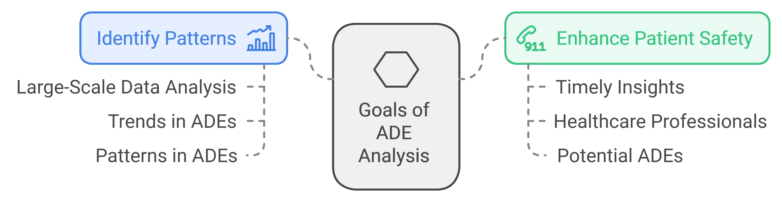
General description
What are Adverse Drug Effects (ADEs)?
Undesirable and harmful reactions resulting from medications.
Need for ADE Analysis:
Early detection
Traditional methods are time-consuming
Role of Big Data and Cloud Computing:
Enables analysis of vast amounts of drug and patient data.
Scalable, fast, and cost-efficient solutions

Slide 3
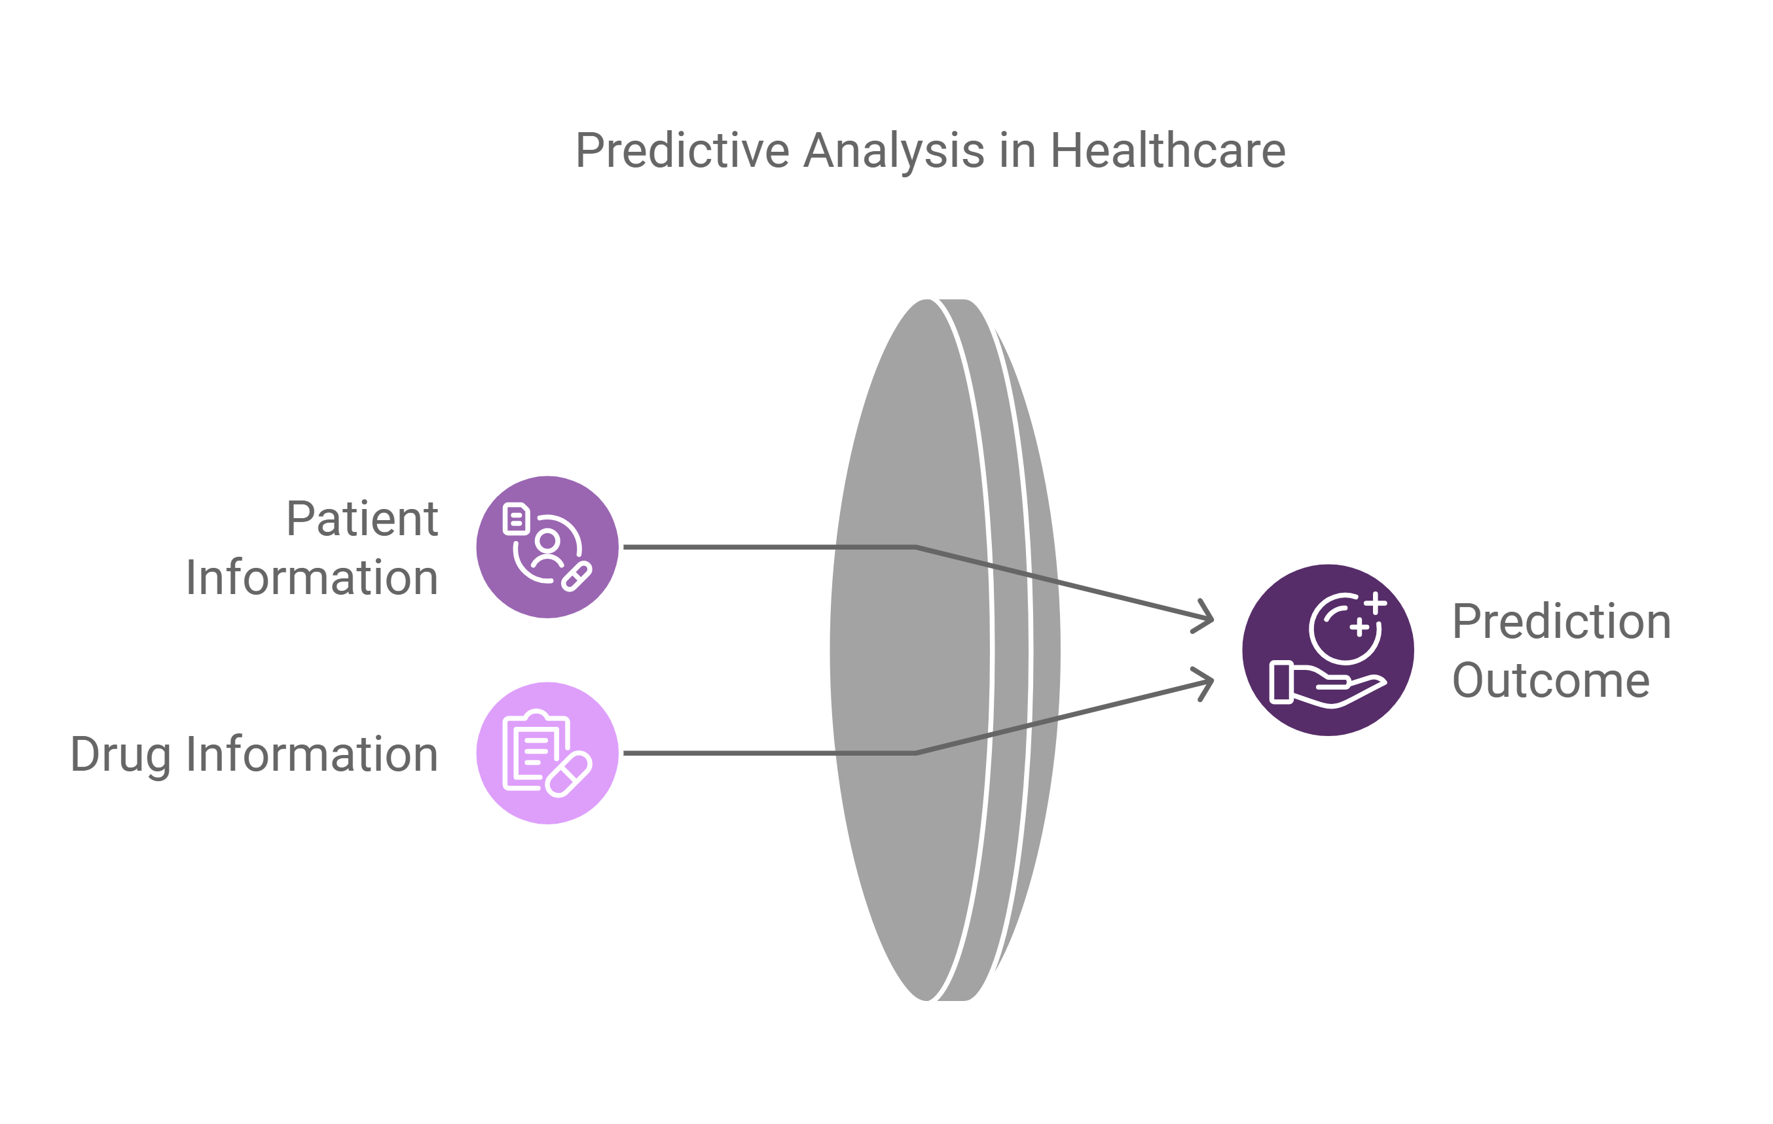
General description
Patient Information:
Seriousness of the disease.
Hospitalization status (whether the patient is hospitalized or not).
Life-threatening condition status.
Patient age
Drug Information:
Drug name
Number of active substances in the drug
Medicinal product details
Prediction Outcome:
Based on input data, the project will predict the reaction outcome.
If the outcome is serious, a recommendation can be made to consult the doctor for alternative drugs.

Slide 4
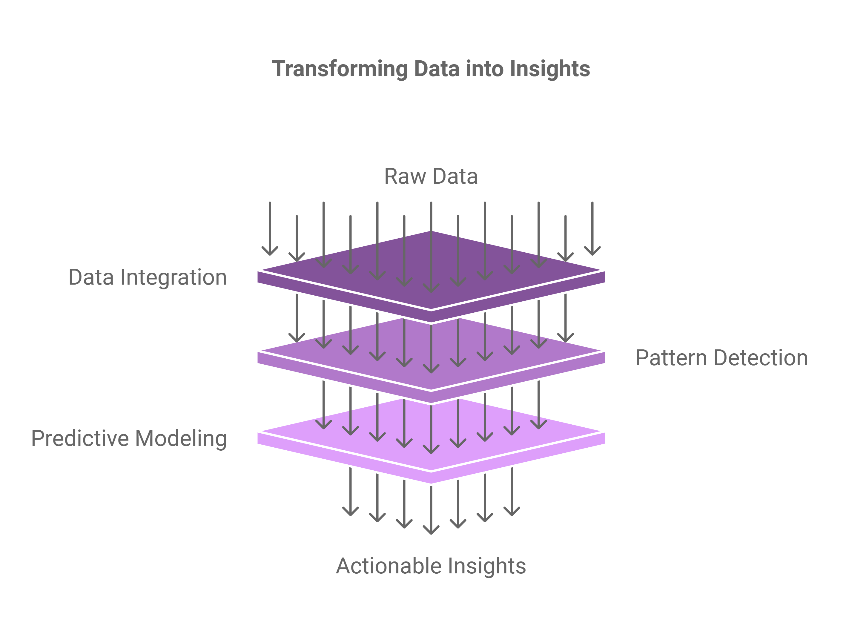
Objectives
Data Integration: Integrate diverse data sources
Pattern Detection: Identify correlations and trends
Develop Predictive Models: Create and validate predictive models to forecast ADEs
Random Forest
Multilayer Perceptron (MLP)

Slide 5
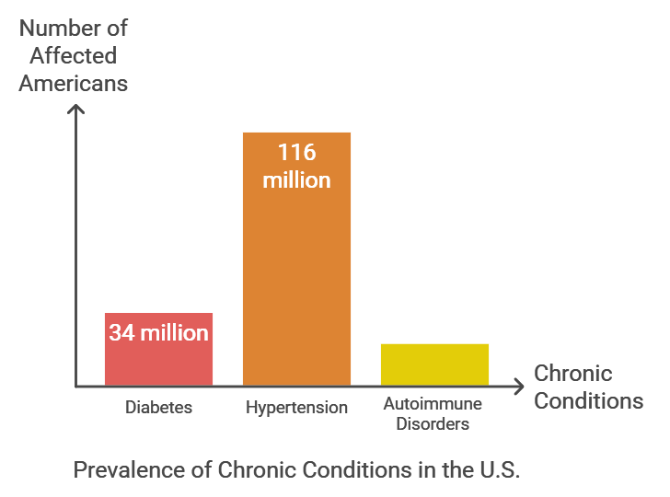
Motivation
High Medication Usage:
70% of adults in the U.S. take one prescription medication.
50% of adults take two or more medications.
Prevalence of Chronic Conditions:
Diabetes: Over 34 million Americans have diabetes, requiring ongoing medication management.
Hypertension: Nearly 116 million adults in the U.S. suffer from high blood pressure.
Autoimmune Disorders: Approximately 20 million Americans are affected by conditions like thyroid disease.

Slide 6
Motivation
Growing Concern of Adverse Drug Effects (ADEs)
Limitations of Traditional Methods
Impact on Healthcare and Patient Safety
Personal Interest in the Topic:
Aiming to leverage advanced technologies to solve real-world healthcare challenges.
Contributing to a critical area where technology can directly impact human well-being.

Slide 7
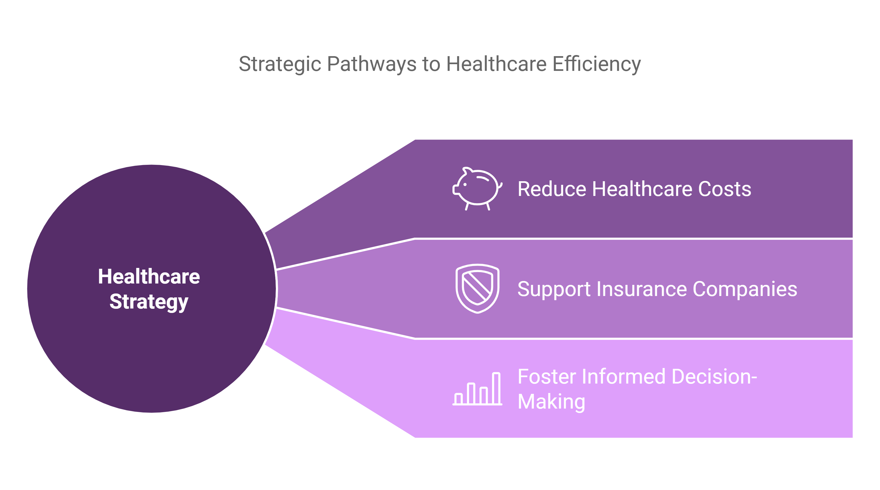
Business Goal
Reduce Healthcare Costs
Support Insurance Companies: Help insurance companies reduce claims related to ADEs, ultimately lowering their overall expenditure on patient care.
Foster Informed Decision-Making

Slide 8

Dataset Description & Collection Process
Source of Data
FDA Adverse Event Reporting System (FAERS):
The dataset contains 4 million rows.
Includes a wide range of drugs, patient demographics, and reaction descriptions.

Slide 9
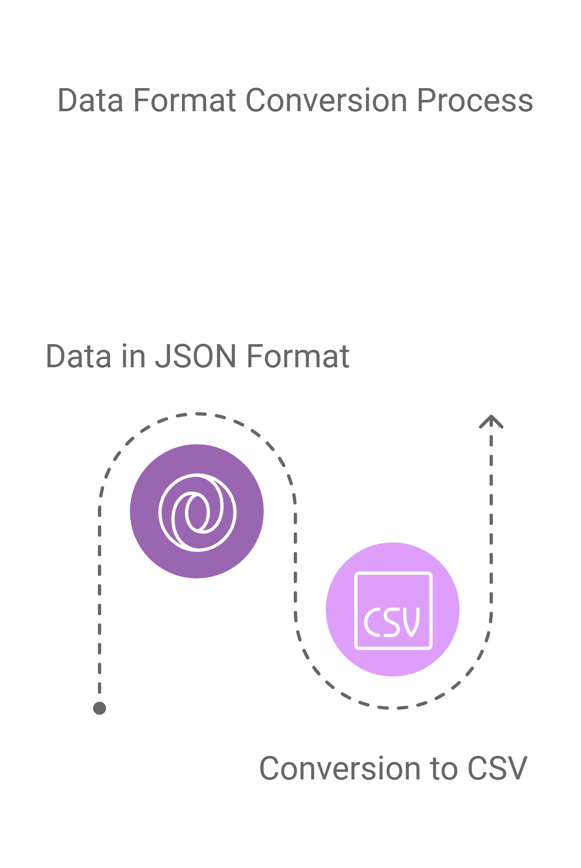
Dataset Description & Collection Process
Dataset Format and Structure
Format: Initially in JSON format.
Structure: Structured fields including:
Patient demographics (age, gender, weight, etc.)
Drug information (drug name, dosage, duration)
Reaction types (symptoms, severity, outcomes)
Conversion to CSV
Parsing JSON using Python to extract relevant columns.

Slide 10
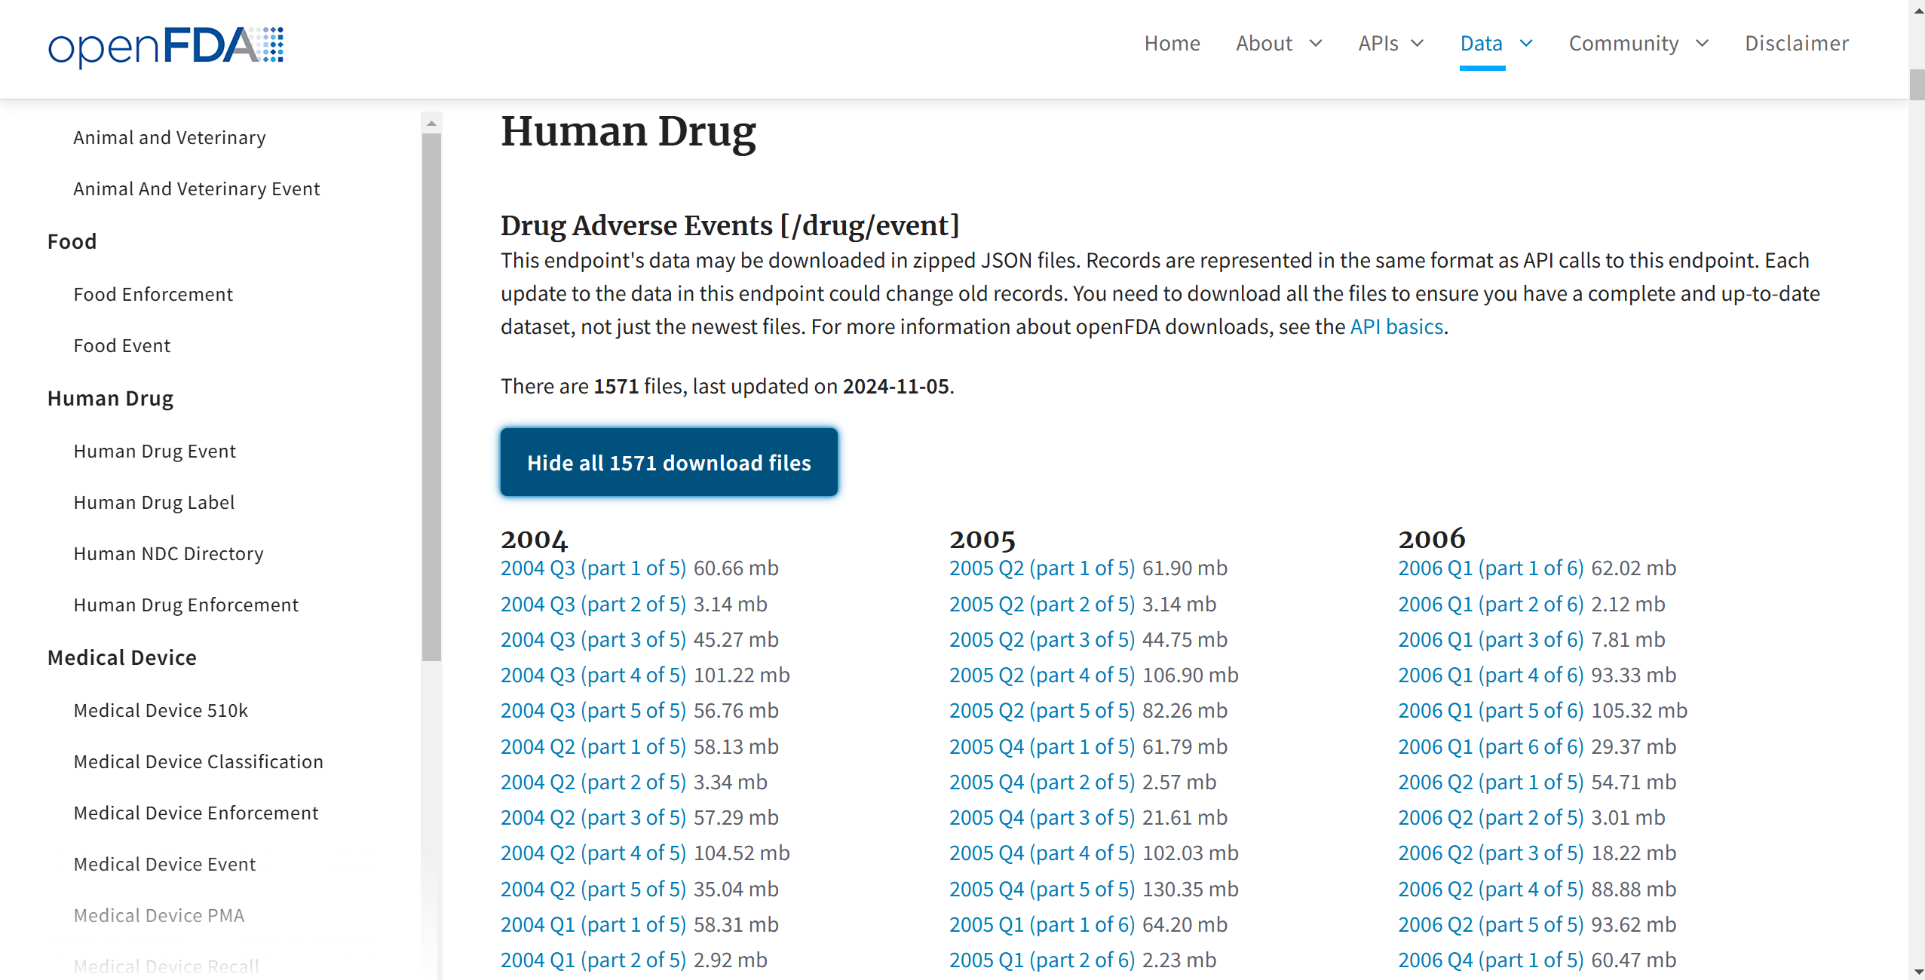
Motivation
High Medication Usage:
Approximately 70% of adults in the U.S. take at least one prescription medication.
Nearly 50% of adults take two or more medications.
Prevalence of Chronic Conditions:
Diabetes: Over 34 million Americans have diabetes, requiring ongoing medication management.
Hypertension: Nearly 116 million adults in the U.S. suffer from high blood pressure, often necessitating multiple medications.
Autoimmune Disorders: Conditions like thyroid disease affect approximately 20 million Americans.

Slide 11
Key Columns and Their Definitions
1. Safetyreportid - Unique identifier for each report.
2. Reactionmeddrapt - Type of adverse reaction (target column).
3. Reactionoutcome - Type of adverse reaction (target column)
4. Drugdosagetext - Information on the prescribed drug dosage.
5. Seriousnessdeath - Indicates if the reaction is classified as serious.

Slide 12
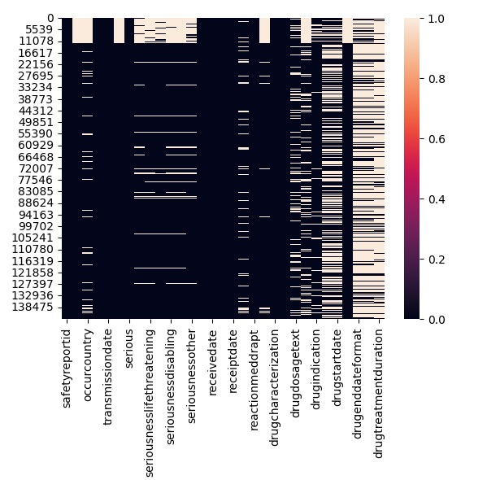
Data Pre-Processing
Drop Columns with More Than 30% Null Values: improve dataset quality and analysis accuracy
Drug Treatment Duration: Calculate the duration between 'drugstartdate' and 'drugenddate' to quantify the treatment period for ADE forecasting.
Feature Reduction: Initially, 43 features were present. After removing the columns with more than 30% null values and feature engineering, we are left with 12 columns.

Slide 13
Data Pipeline and Workflow
1. Data Collection - Import JSON files from FDA databases and store them in Google Cloud Storage.
3. Data Processing on Apache Spark
4. Exploratory Data Analysis (EDA)
5. ML Classification Model Implementation.
5. Interpretation and Reporting

Slide 14
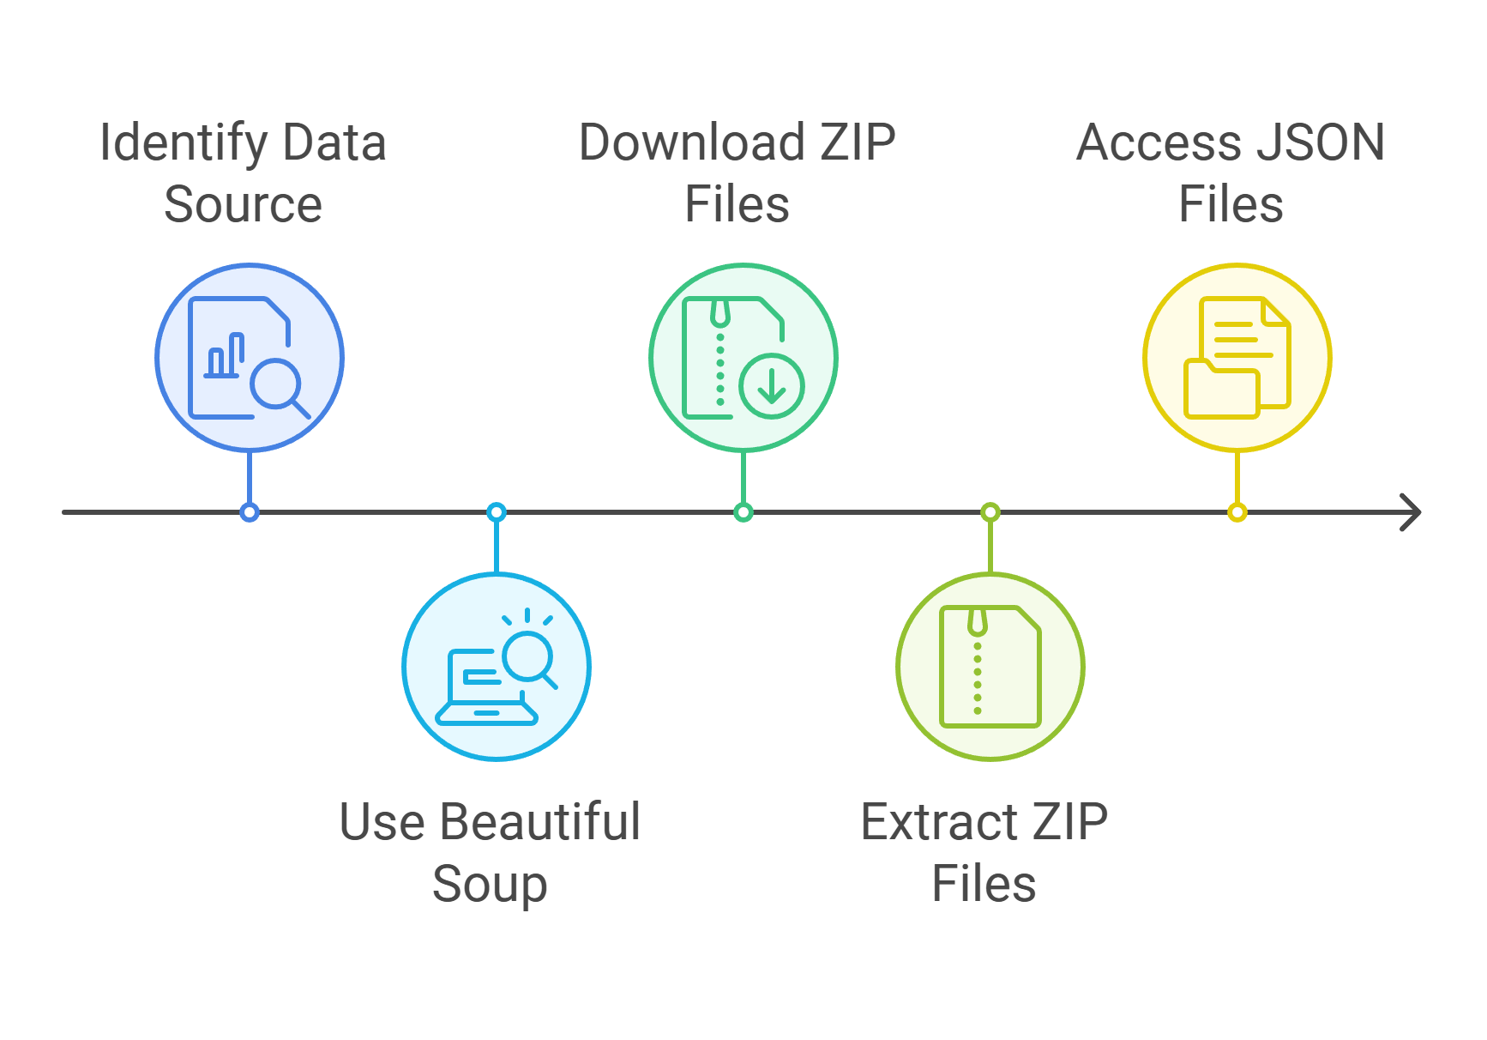
Data Collection

Slide 15
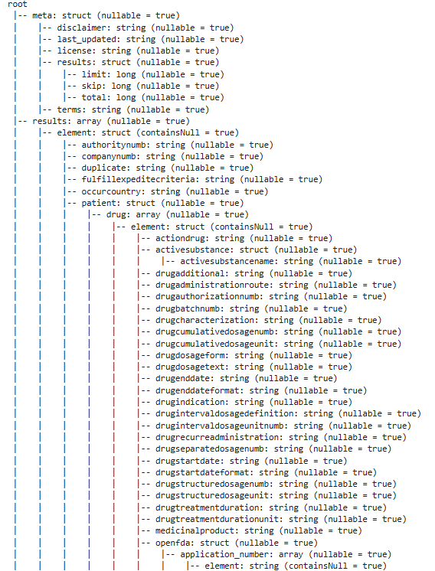
Data Schema

Slide 16
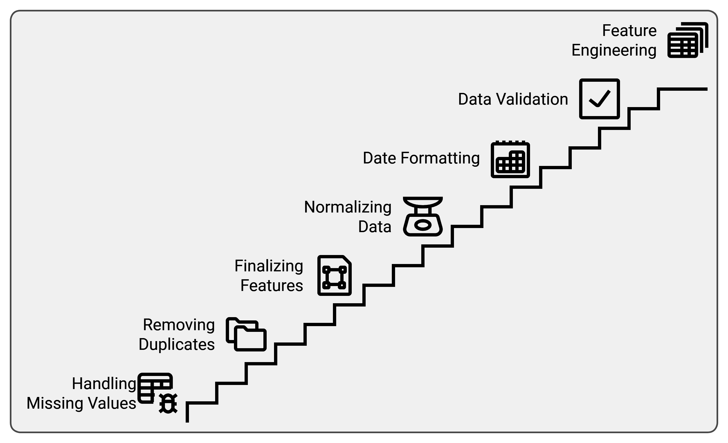
Data Cleaning & Preprocessing

Slide 17
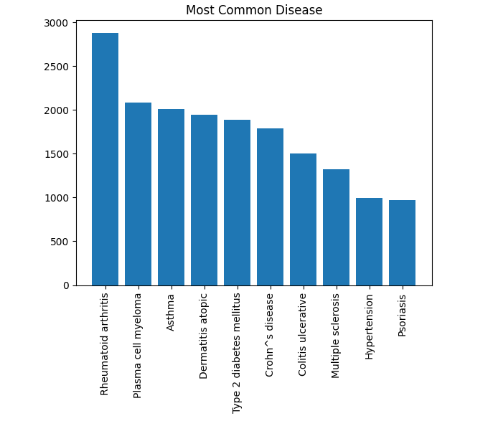
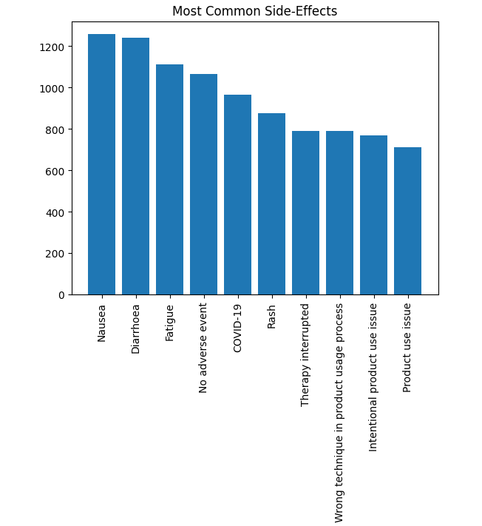
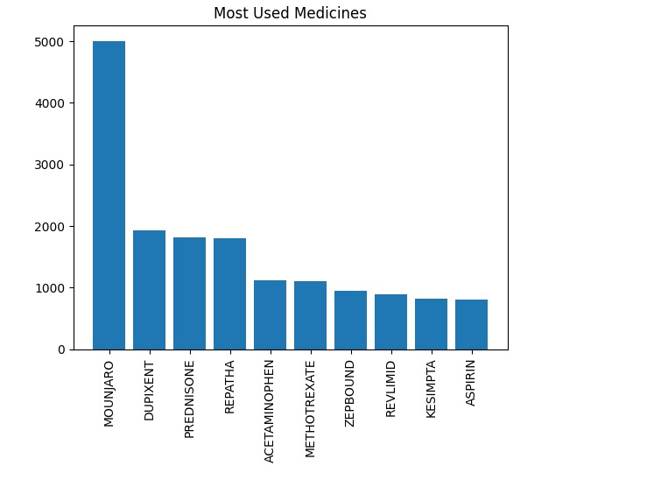
Data Visuals

Slide 18
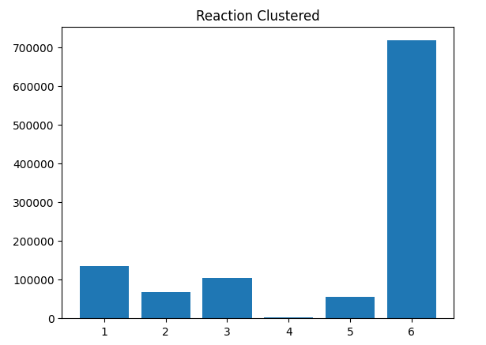
Clustering
'Abdominal abscess', 'Abdominal adhesions', 'Abdominal bruit', 'Abdominal compartment syndrome', 'Abdominal discomfort’
'Adenocarcinoma', 'Adenocarcinoma of colon', 'Adenoma benign', 'Adenotonsillectomy', 'Adenoviral encephalitis', 'Adenovirus infection', 'Adhesion’.
'Adenocarcinoma of colon', 'Adenocarcinoma pancreas', 'Adenoma benign', 'Adenomyosis', 'Adenovirus infection', 'Adhesion', 'Adjusted calcium increased', 'Adjustment disorder', 'Adjustment disorder with depressed mood'
'Vomiting', 'Vulval cancer metastatic', 'Vulvovaginal dryness', 'Walled-off pancreatic necrosis', 'Weight decreased', 'Weight increased’,
Wound dehiscence', 'Wound infection', 'Wound infection staphylococcal', 'Wound sepsis', 'Wrong patient received product', 'Wrong product administered
'Xanthelasma', 'Xeroderma', 'Xerophthalmia', 'Xerosis', 'Yawning', 'Yellow skin', 'Yersinia infection

Slide 19
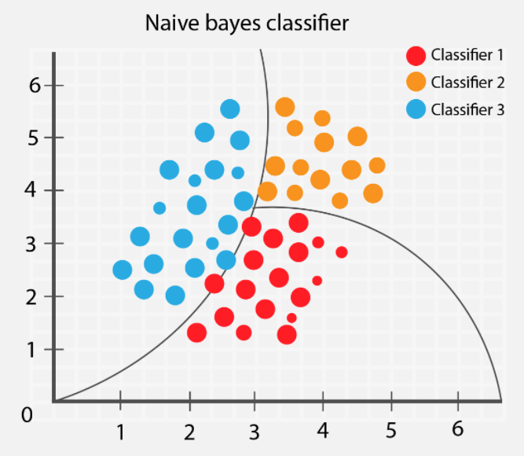
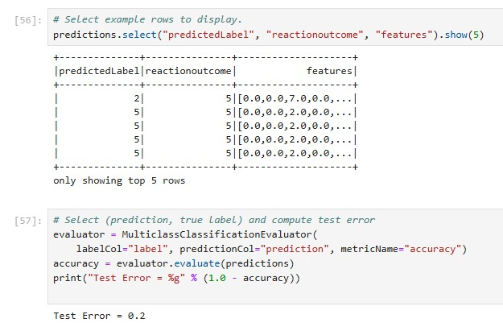
Develop Predictive Models

Slide 20
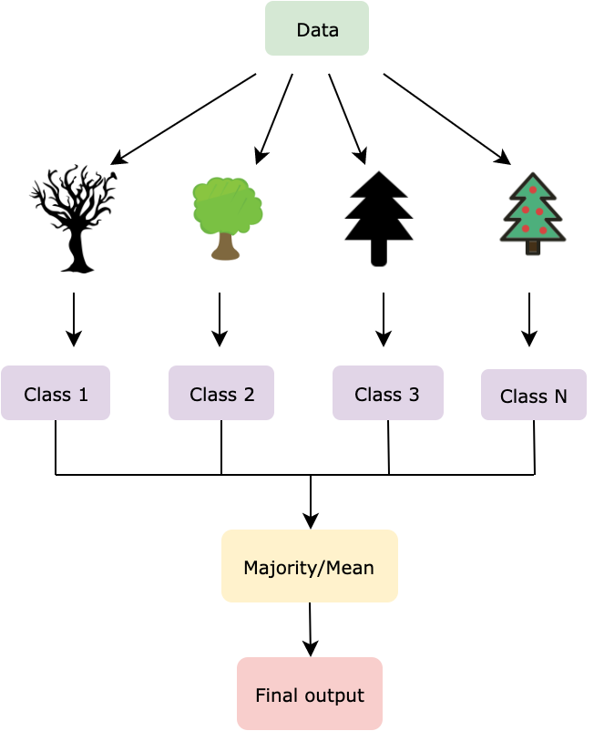
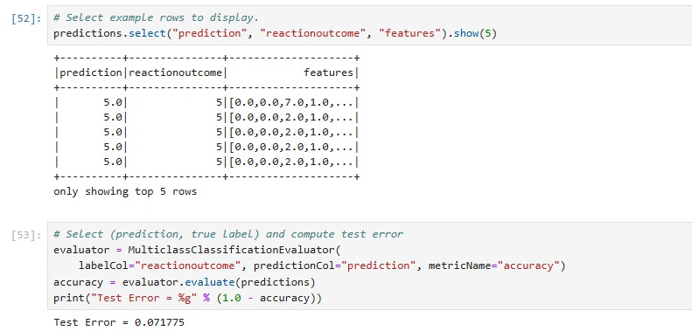
Develop Predictive Models
Random Forest

Slide 21
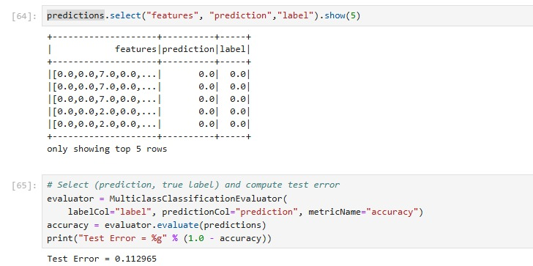
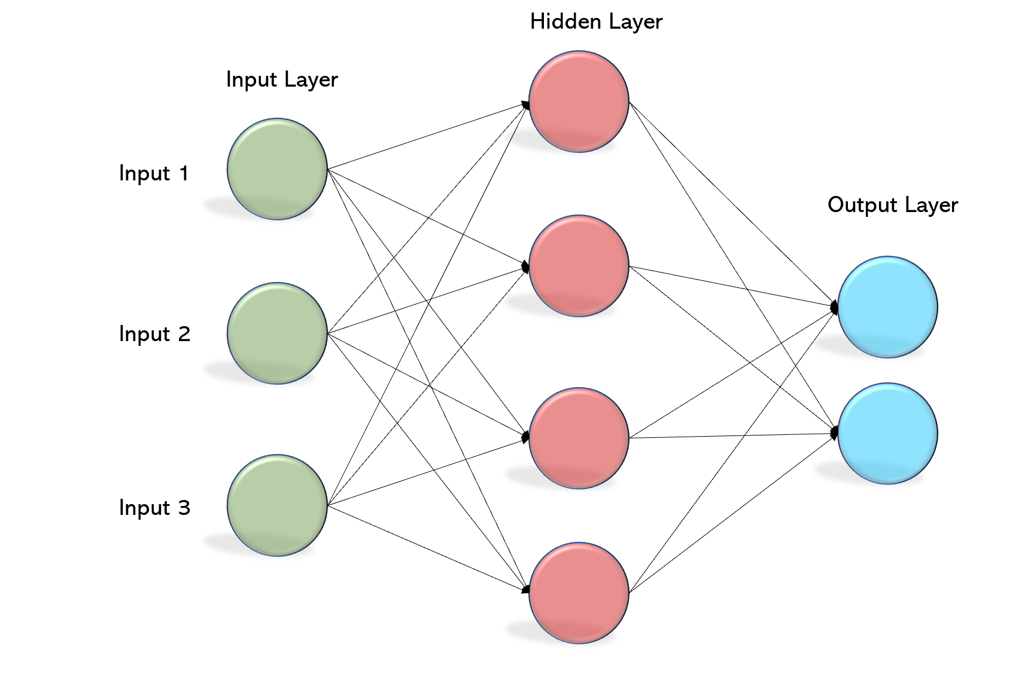
Develop Predictive Models
MLP

Slide 22

Importance and Impact of the Project
Contribution to Drug Safety: Provides insights to healthcare on drug risks, highlighting high-risk drugs and potential demographic susceptibilities.
Support for Regulatory Bodies: Assists FDA and others in refining drug approval processes.
Public Health Impact: Potentially reduces ADR-related hospitalizations, improving patient safety and therapeutic effectiveness.

Slide 23

Expected Outcomes and Insights
1. Adverse Reaction Profiles - Summary of common adverse effects per drug.
2. Demographic-Based Insights - Patterns in reactions based on age and gender.
3. Risk Identification - List of high-risk drugs and doses.
4. Geographic Analysis - ADR trends by region.
5. Recommendations - Best practices for healthcare providers.

Slide 24

Challenges and Solutions
Data Complexity and Volume: Addressed by Apache Spark and GCP.
Data Inconsistencies and Missing Values: Will be resolved through rigorous data cleaning.
Interpretability of Results: Clear visualizations and summary statistics to convey insights.

Slide 25
Future Enhancements and Scalability
1. Real-Time ADR Analysis: Integrate real-time data feeds for dynamic monitoring of drug safety profiles.
2. Advanced Machine Learning Models: Explore classification models to predict high-risk cases.
3. Broader Dataset Integration: Incorporate additional data sources like lifestyle or co-morbidity information for a holistic view of ADRs.

Slide 26

Conclusion and Key Takeaways
Summary of Key Points: Comprehensive ADR analysis using big data, cloud infrastructure, and scalable processing.
Identified crucial insights on drug safety to aid clinical decision-making.
Final Thought: This project demonstrates the power of data-driven insights in enhancing drug safety, with potential to save lives and reduce healthcare costs.

Slide 27
Thank you

